Slide 1
Chapter 4
Elasticity
© 2019 McGraw-Hill Education. All rights reserved. Authorized only for instructor use in the classroom. No reproduction or distribution without the prior written consent of McGraw-Hill Education.

Slide 2
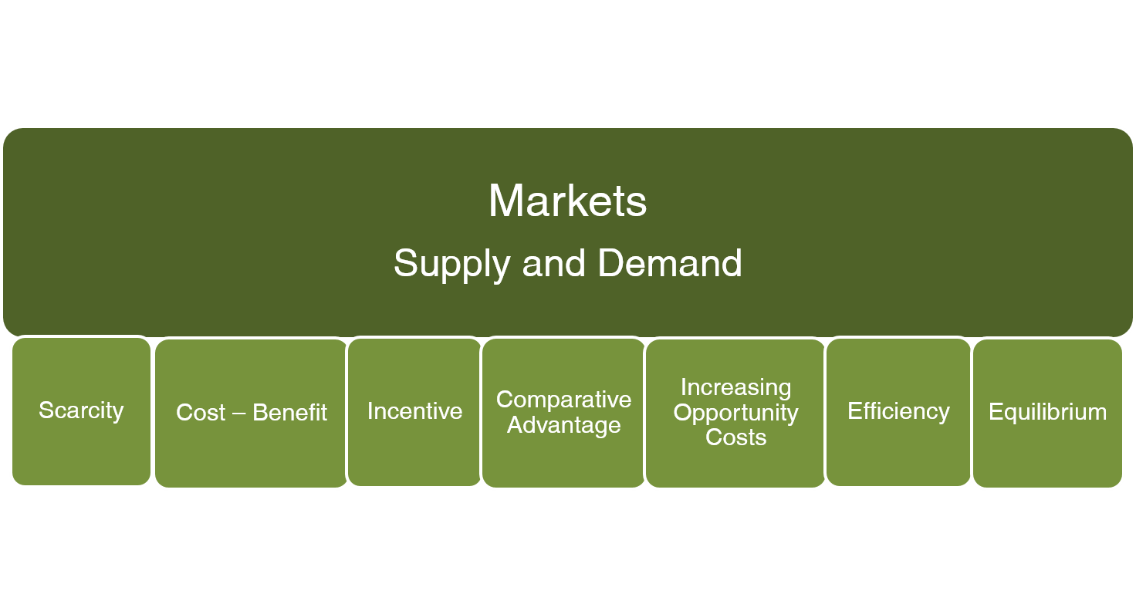
The Basics

Slide 3
Learning Objectives
Define the price elasticity of demand and explain what determines whether demand is elastic or inelastic.
Calculate the price elasticity of demand using information from the demand curve.
Understand how changes in the price of a good affect total revenue and total expenditure depending on the price elasticity of demand for the good.
Explain the cross-price elasticity of demand and income elasticity of demand.
Discuss the price elasticity of supply, explain what determines whether supply is elastic or inelastic, and calculate the price elasticity of supply using information from a supply curve.

Slide 4
Drug Enforcement and Local Theft
Hypothesis
Drug users steal to buy drugs
Increasing drug enforcement will decrease theft
Analysis
Increased enforcement reduces supply of drugs
Price of drugs increases
Quantity demanded decreases
Theft goes down ONLY IF total expenditure on drugs decreases
How responsive is quantity demanded to price?

Slide 5
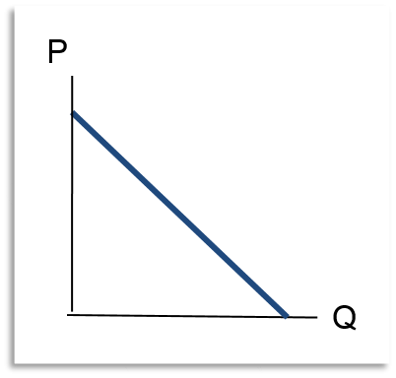
Price Elasticity of Demand
Price elasticity of demand is defined as the percentage change in quantity demanded from a 1% change in price
Measure of responsiveness of quantity demanded to changes in price
Example:
Price of beef decreases 1%
Quantity of beef demanded increases 2%
Price elasticity of demand is – 2

Slide 6
Calculate Price Elasticity
Symbol for elasticity is ε
Lower case Greek letter epsilon
Demand elasticity will always be negative, but we drop the minus and treat it as positive
Price elasticity of demand is always negative because price changes are always in the opposite direction from changes in quantity demanded.
Ignore the negative sign, use absolute value

Slide 7
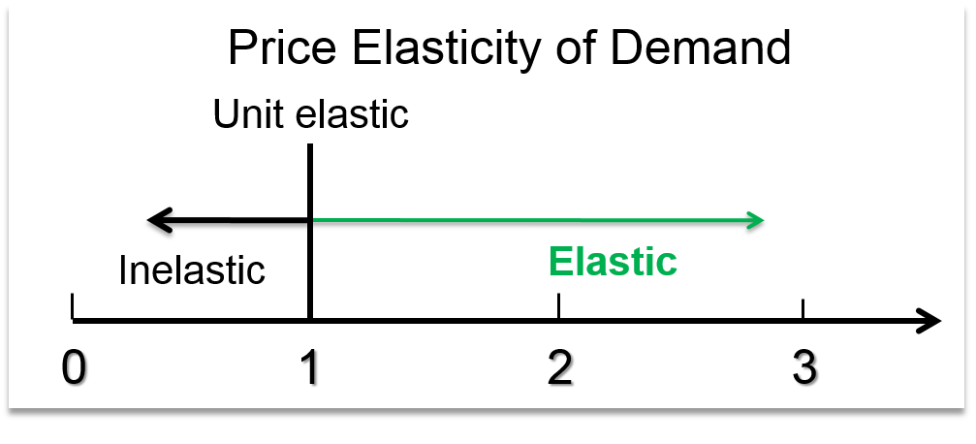
Elastic Demand
If price elasticity is greater than 1, demand is elastic
Percentage change in quantity is greater than percentage change in price
Demand is responsive to price

Slide 8
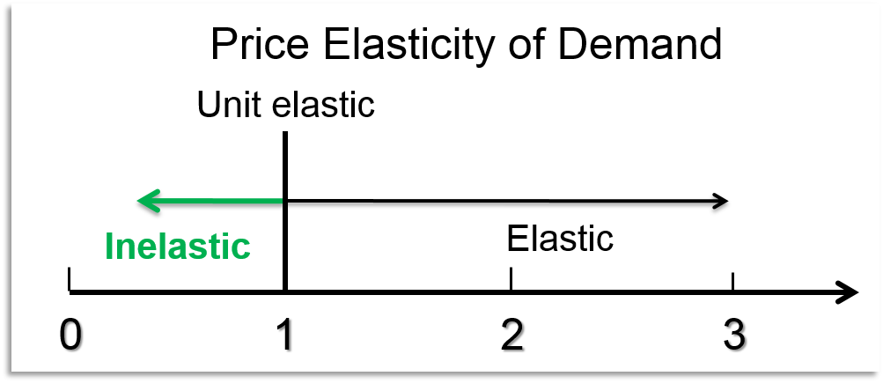
Inelastic Demand
If price elasticity is less than 1, demand is inelastic
Percentage change in quantity is less than percentage change in price
Quantity demanded is not very responsive to price

Slide 9
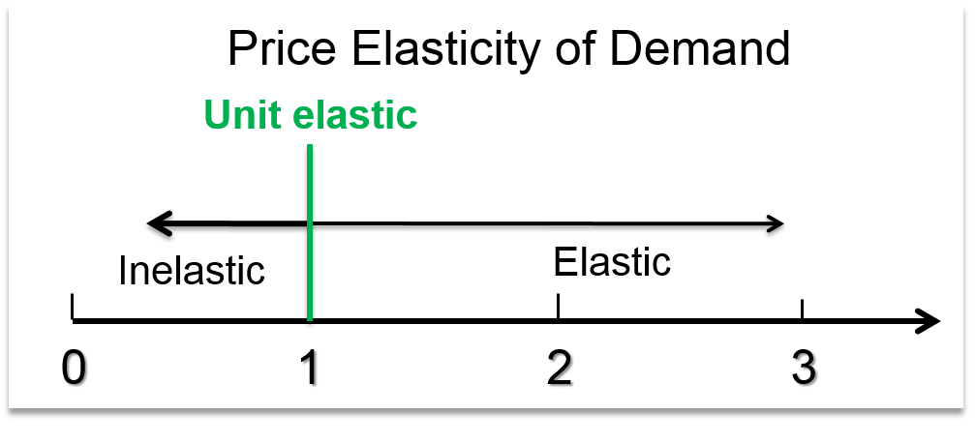
Unit Elastic Demand
If price elasticity is 1, demand is unit elastic
Price and quantity change by the same percentage

Slide 10
 | Old | New | % Change
Price | $1.00 | $0.97 | 3%
Quantity | 400 | 404 | 1%

Slide 11
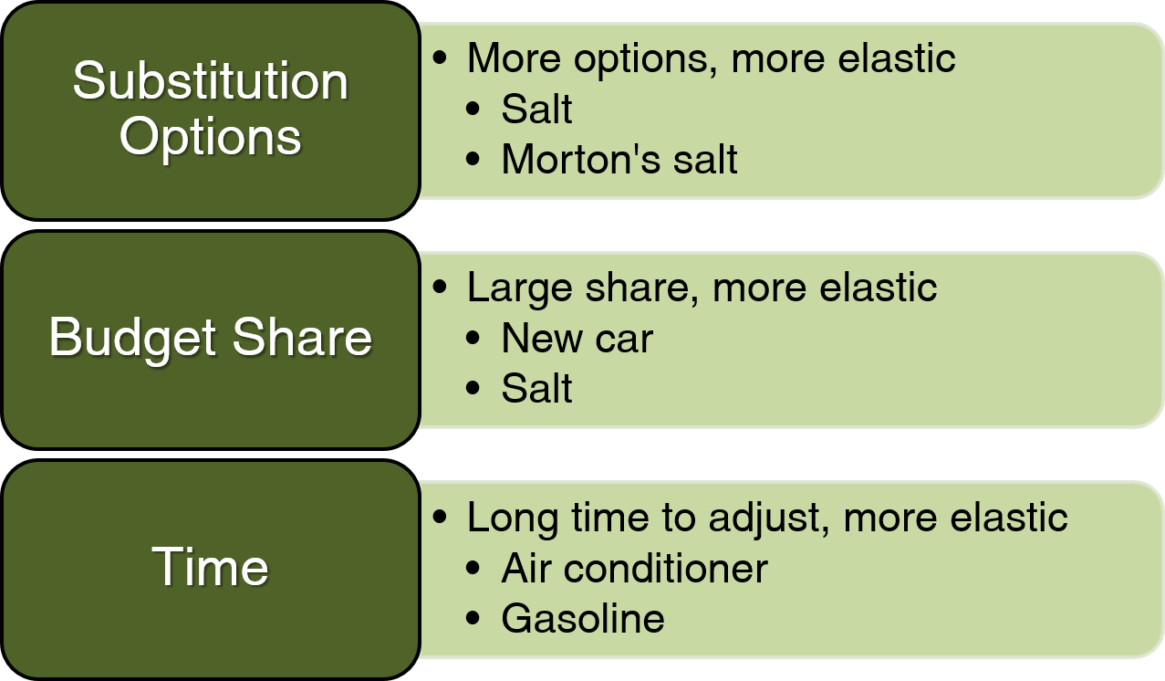
Determinants of Price Elasticity of Demand

Slide 12
Examples of Elasticities
Green peas | 2.80
Restaurant meals | 1.63
Beer | 1.19
Coffee | 0.25
Automobiles | 1.35
Foreign air travel | 0.77
Movies | 0.87
Theater, opera | 0.18

Slide 13
Taxes and Teen Smoking
Hypothesis:
Teens’ demand for cigarettes is inelastic
Demand is driven by peers
But, teens also lack income
Analysis:
Cigarette taxes increase the price of cigarettes
Some teens will smoke less or quit altogether
These teens will influence others to quit
Higher taxes are likely to reduce teen smoking

Slide 14
Unintended Effects of the Yacht Tax
Hypothesis
Luxury tax on yachts over $100,000 will yield $31 million in tax revenue
Analysis
Price elasticity of demand is high
Actual tax revenue $16.6 million
People bought yachts outside US to avoid tax (these are close substitutes)
7,600 jobs in US boating industry lost
Outcome: tax repealed after 2 years

Slide 15
Price Elasticity Notation
ΔQ is the change in quantity
ΔQ / Q is percentage change in quantity
ΔP is change in price
ΔP / P is percentage change in price

Slide 16
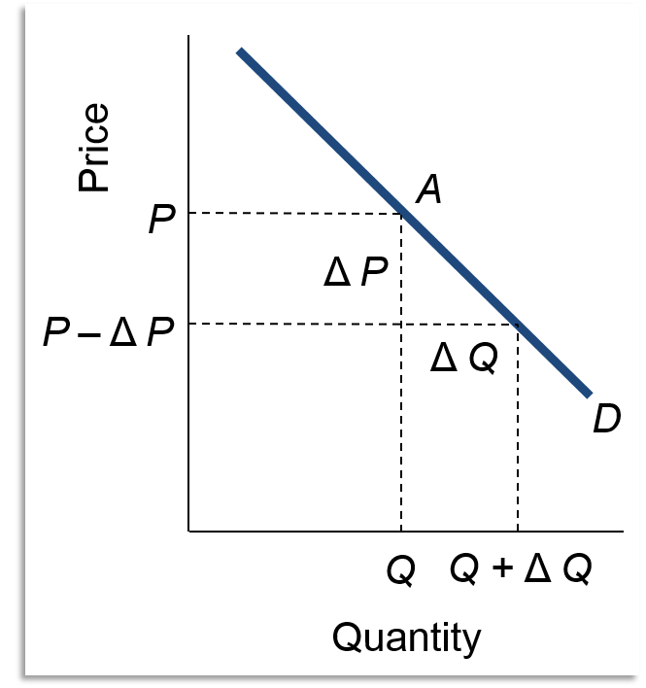
Price Elasticity: Graphical View 1
Access the text alternative for these images

Slide 17
Price Elasticity: Graphical View 2
At point A
P = 8
Q = 3
Slope = 20 / 5 = 4

Slide 18
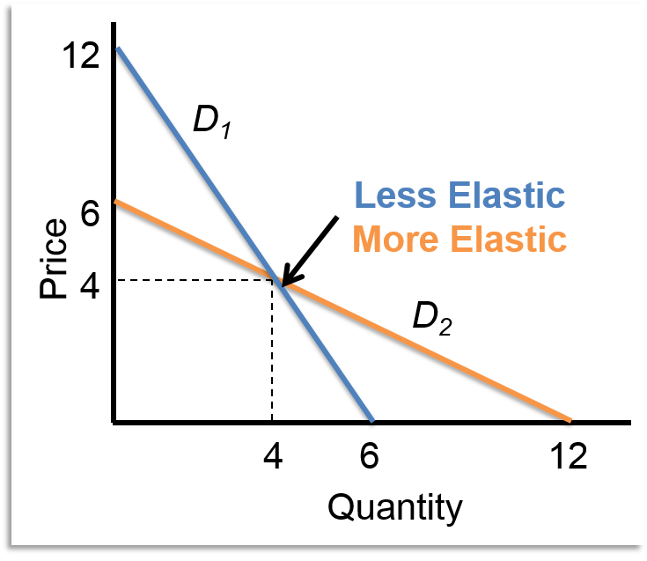
Price Elasticity and Slope
When two demand curves cross
P / Q is same for both curves
(1 / slope) is smaller for the steeper curve
At the common point demand is less price elastic for the steeper curve

Slide 19
Price Elasticity on a Straight-Line Demand Curve
Price elasticity is different at each point
Slope is the same for the demand curve
P/Q decreases as price goes down and quantity goes up

Slide 20
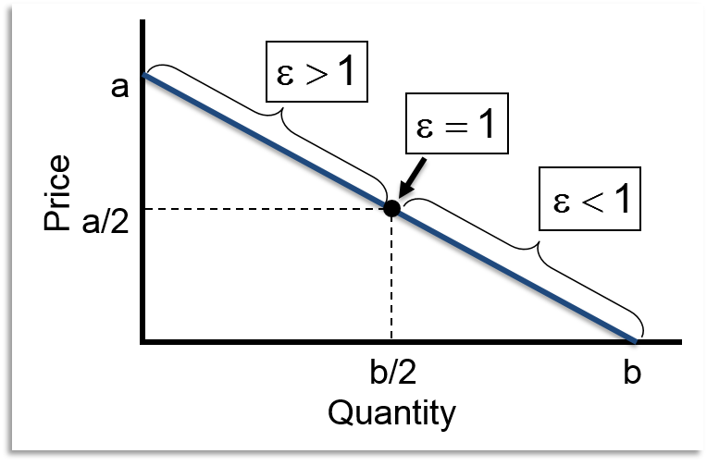
Price Elasticity Pattern
Price elasticity changes systematically as price goes down
At high P and low Q, P / Q is large
Demand is elastic
At the midpoint, demand is unit elastic
At low P and high Q, P / Q is small
Demand is inelastic

Slide 21
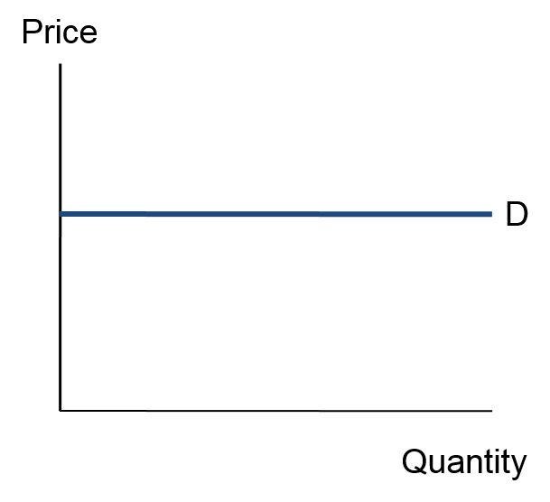
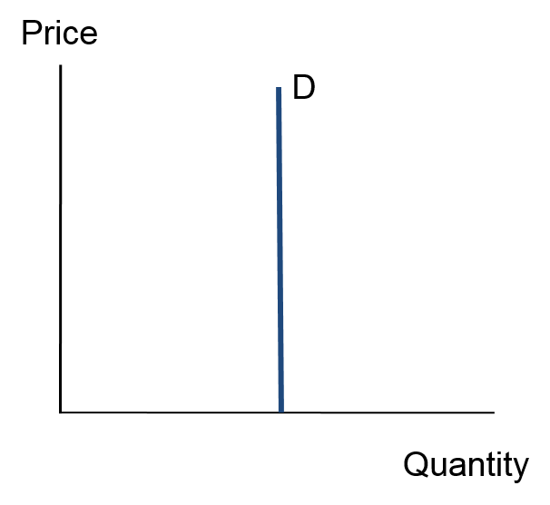
Two Special Cases
Perfectly Elastic Demand
Infinite price elasticity of demand
Perfectly Inelastic Demand
Zero price elasticity of demand

Slide 22
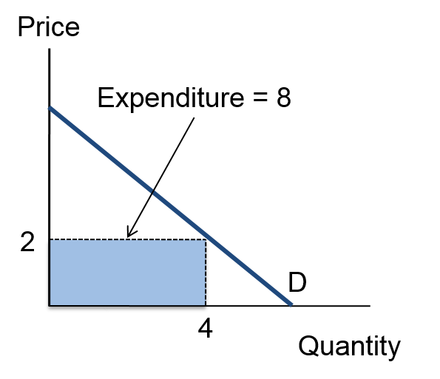
Elasticity and Total Expenditure
When price increases, total expenditure can increase, decrease or remain the same
The change in expenditure depends on elasticity
Terminology: total expenditure = total revenue
Calculate as P × Q
Graphing idea: total expenditure is the area of a rectangle with height P and width Q
Example: P = 2 and Q = 4

Slide 23
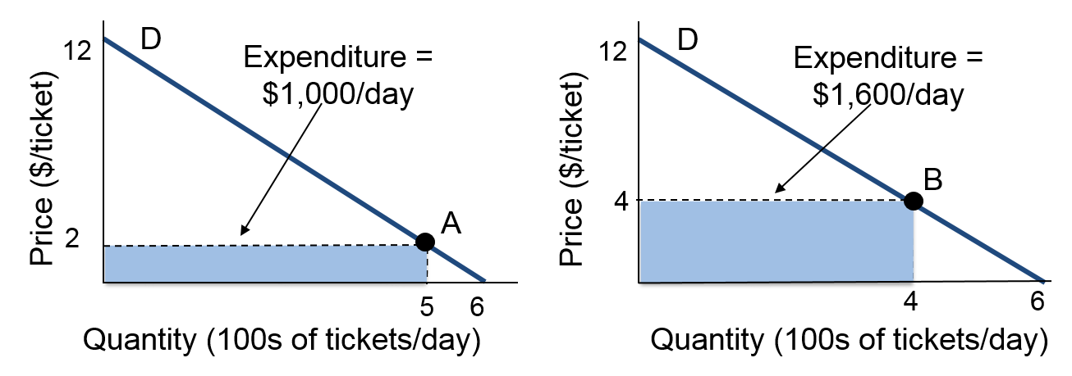
Price Elasticity and Total Expenditure 1
Movie ticket price increases from $2 to $4
A and B are both below the midpoint of the curve
Inelastic portion of the demand curve
Total revenue increases when price increases

Slide 24
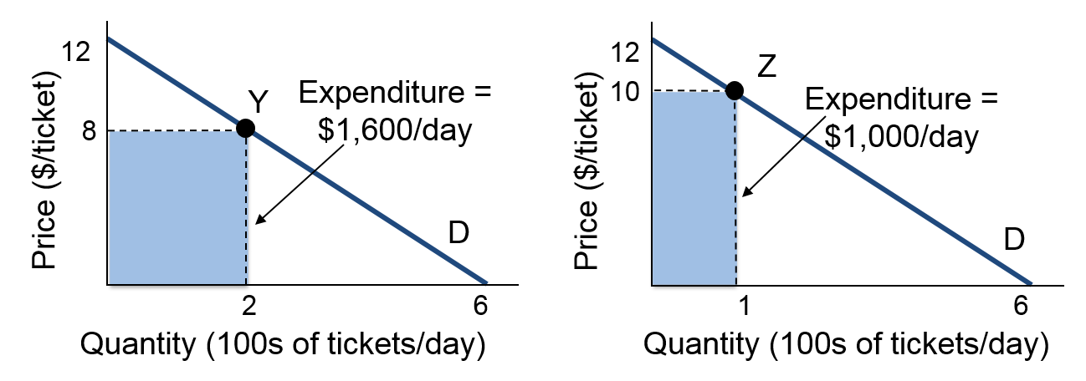
Price Elasticity and Total Expenditure 2
Movie ticket price increases from $8 to $10
Prices are both above the midpoint of the curve
Elastic portion of the demand curve
Total revenue decreases

Slide 25
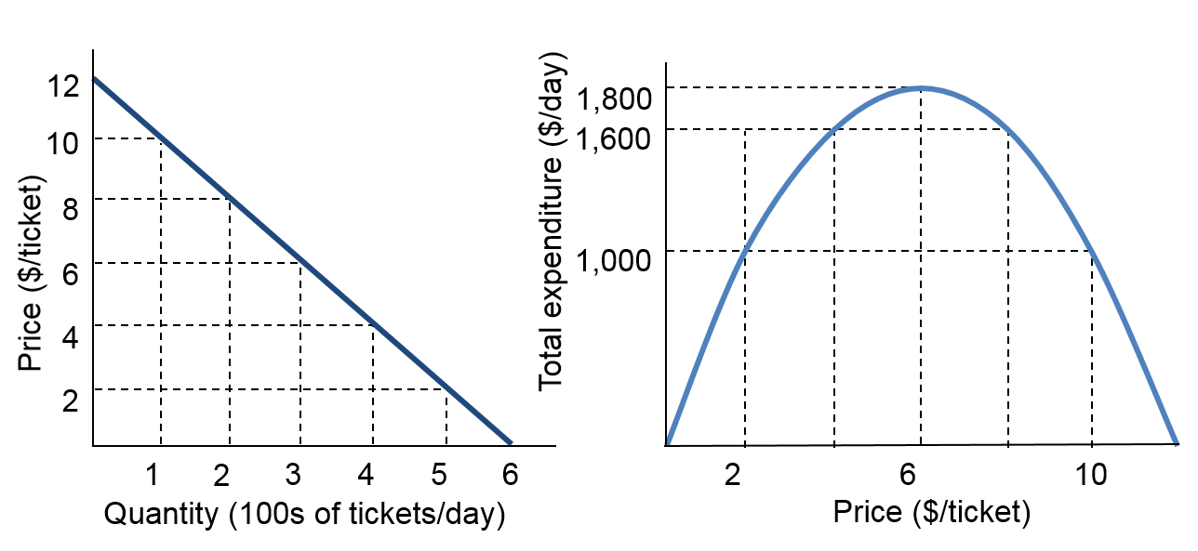
The Effect of a Price Change on Total Expenditure
Price | $12 | $10 | $8 | $6 | $4 | $2 | $0
Quantity | 0 | 1,000 | 2,000 | 3,000 | 4,000 | 5,000 | 6,000
Expenditure | $0 | $1,000 | $1,600 | $1,800 | $1,600 | $1,000 | $0

Slide 26
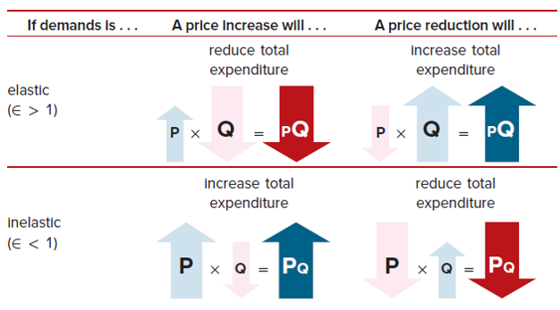
Elasticity, Price Change, and Expenditure
Access the text alternative for these images

Slide 27
Cross-Price Elasticity of Demand
Substitutes and complements affect demand
Cross-price elasticity of demand is defined as the percentage change in quantity demanded of good A from a 1 percent change in the price of good B
Sign of cross-price elasticity shows relationship between the goods
Complements have negative cross-price elasticity
Substitutes have positive cross-price elasticity

Slide 28
Income Elasticity of Demand
Income elasticity of demand is defined as the percentage change in quantity demanded from a 1 percent change in income
Income elasticity of demand can be positive or negative
Positive income elasticity is a normal good
Negative income elasticity is an inferior good

Slide 29
Price Elasticity of Supply 1
Price elasticity of supply
Percentage change in quantity supplied from a 1 percent change in price

Slide 30
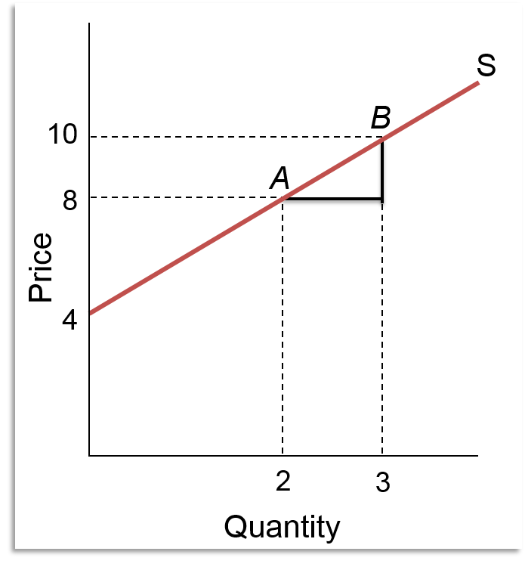
Price Elasticity of Supply 2
If supply curve has a positive intercept
Price elasticity of supply decreases as Q increases
Graph shows
Slope = 2
At A, P = 8 and Q = 2
Price elasticity of supply = (8 / 2) (1 / 2) = 2.00
At B, P = 10 and Q = 3
Price elasticity of supply = (10 / 3) (1 / 2) = 1.67

Slide 31
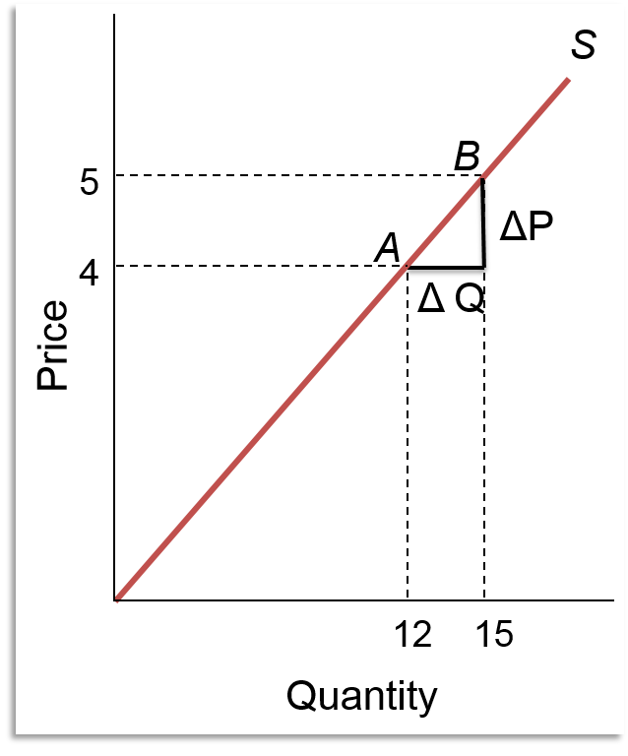
Price Elasticity of Supply 3
If supply curve has a zero intercept
Price elasticity of supply is 1.00
Graph shows
Slope = 1 / 3
At A, P = 4 and Q = 12
Price elasticity of supply = (4 / 12) (3) = 1.00
At B, P = 5 and Q = 15
Price elasticity of supply = (5 / 15) (3) = 1.00

Slide 32
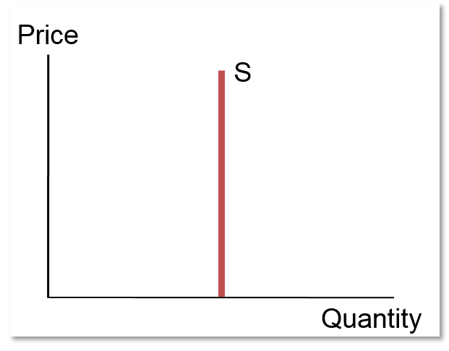
Perfectly Inelastic Supply
Zero price elasticity of supply
No response to change in price
Example: land on Manhattan
Supply is completely fixed
Any one-of-a-kind item has perfectly inelastic supply
Work of art (Mona Lisa)
Hope Diamond

Slide 33
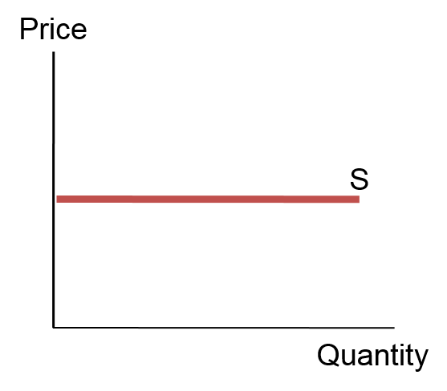
Perfectly Elastic Supply
Infinite price elasticity of supply
Sell all you can at a fixed price
Inputs purchased at a constant price
No volume discounts
Constant proportions of production
Lemonade example
Cost of production is 14¢ at all levels of Q
Marginal cost P = 14¢

Slide 34
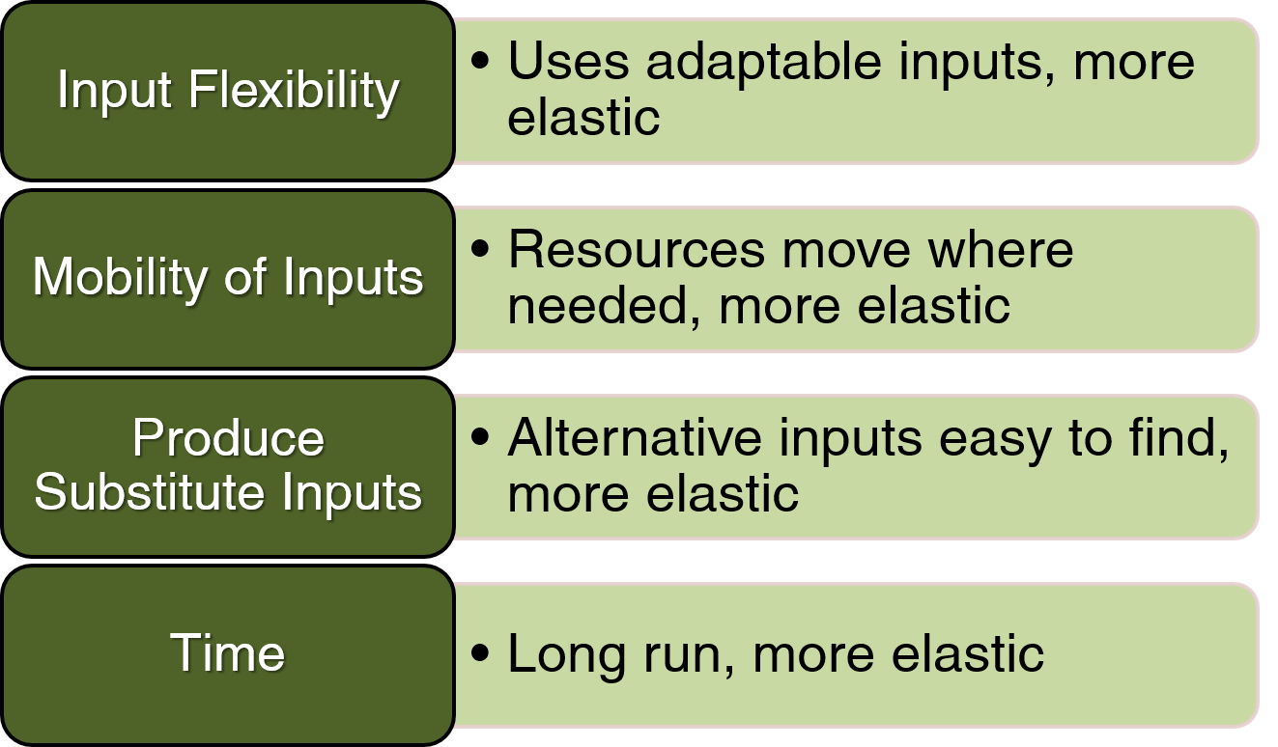
Determinants of Price Elasticity of Supply

Slide 35
Gas Prices and Car Prices
Gasoline Prices
Short-run elasticity of demand is smaller
Difficult to adjust quickly to changes in price
Supply fluctuates more often and by larger amounts
Some oil-producing countries are unstable
Speculation about instability
Car Prices
Short-run elasticity of demand is greater
Timing of purchase can be adjusted to price changes
Supply of cars is relatively stable
Inputs are readily available
Production lines yield predictable, steady output levels

Slide 36
Supply Bottleneck: Unique Inputs
Over time, most producers develop alternative production methods and a variety of input choices
The more flexible the production process, the more elastic supply
When production relies on a single input, supply is highly inelastic
No alternatives to singular talent
Sports stars
Actors and musicians
Bill Gates, Warren Buffet, George Soros, Carl Icahn

Slide 37
Chapter 4 Appendix
The Midpoint Formula for Demand Elasticity
© 2019 McGraw-Hill Education. All rights reserved. Authorized only for instructor use in the classroom. No reproduction or distribution without the prior written consent of McGraw-Hill Education.

Slide 38
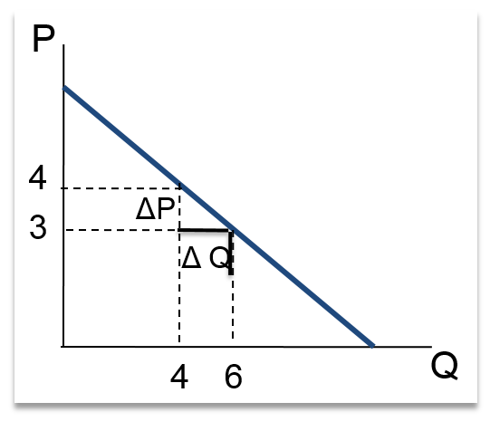
The Midpoint Formula for Elasticity of Demand 1
Elasticity is different at each point on the demand curve
Compare 2 points and get 2 answers
Depends on which point is the starting point
Start at A and elasticity is 2
Start at B and elasticity is 1
A more stable solution is needed
Use the midpoint formula

Slide 39
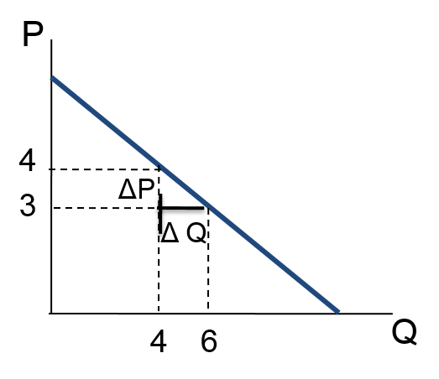
The Midpoint Formula for Elasticity of Demand 2
Midpoint formula
Use average quantity in the numerator
Use average price in the denominator
Elasticity using midpoint formula is 1.40

Slide 40
Accessibility Content: Text Alternatives for Images

Slide 41
Price Elasticity: Graphical View 1 Text Alternative
The graph plots two demand curves for Quantity to Price. The graph shows the downward-sloping demand curve, D1, originating at (0, 12), intersecting point (4, 4) and ending at (6, 0). The second downward-sloping demand curve, D2, originates at (0, 6), intersects point (4, 4), and ends at (12, 0).
Return to slide containing original image

Slide 42
Elasticity, Price Change, and Expenditure Text Alternative
The first row illustrates the equations when demand is elastic where E is greater than 1. An increase in price will reduce total expenditure and the equation shows that Price increase (P) multiplied by a decrease in quantity (Q) will equal a decrease in total expenditure (PQ). A reduction in price will increase total expenditure and the equation shows that Price decrease (P) multiplied by a increase in quantity (Q) will equal an increase in total expenditure (PQ). The second row illustrates the equations when demand is inelastic where E is less than 1. An increase in price will increase total expenditure and the equation shows that Price increase (P) multiplied by a decrease in quantity (Q) will equal an increase in total expenditure (PQ). A reduction in price will reduce total expenditure and the equation shows that Price decrease (P) multiplied by an increase in quantity (Q) will equal a decrease in total expenditure (PQ).
Return to slide containing original image

